Slide 1
SQL Session 4 Select Queries Basics

Slide 2
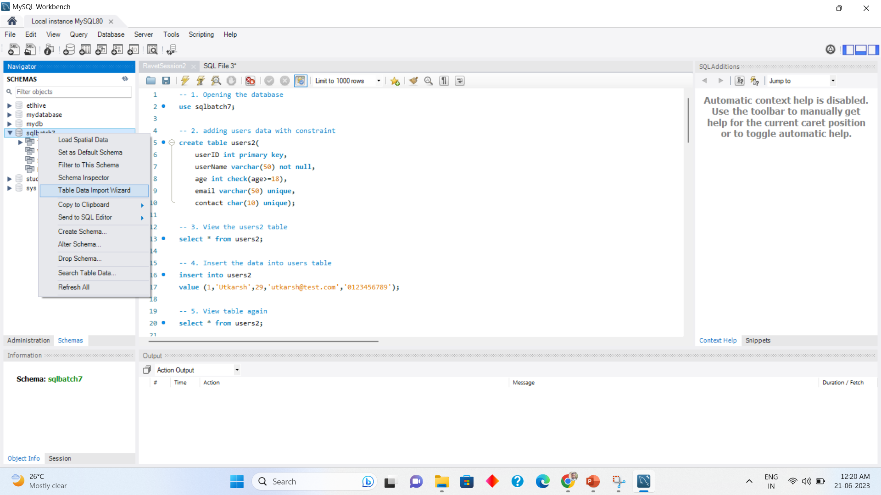
Using csv file as table in mySQL
Right Click
Database
Table data import
Wizard

Slide 3
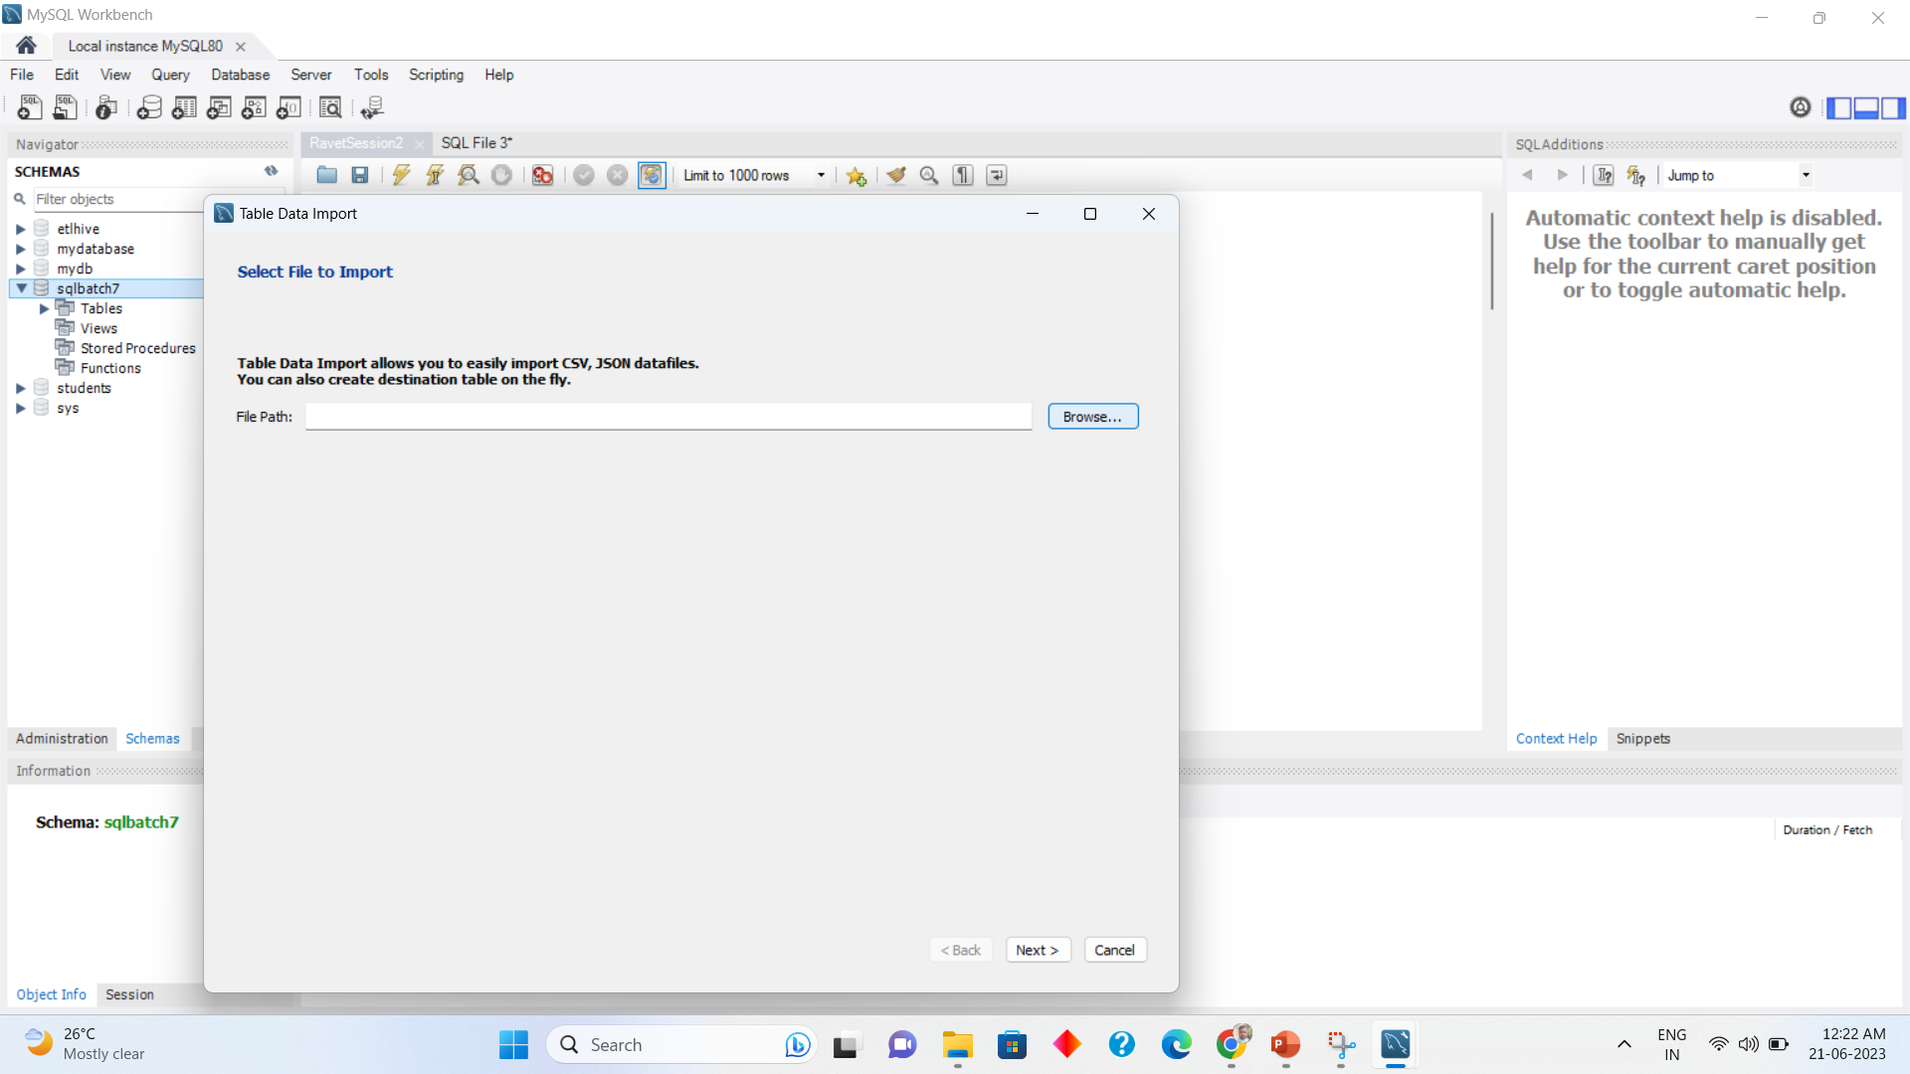
Importing CSV file continued 1
Click Browse

Slide 4
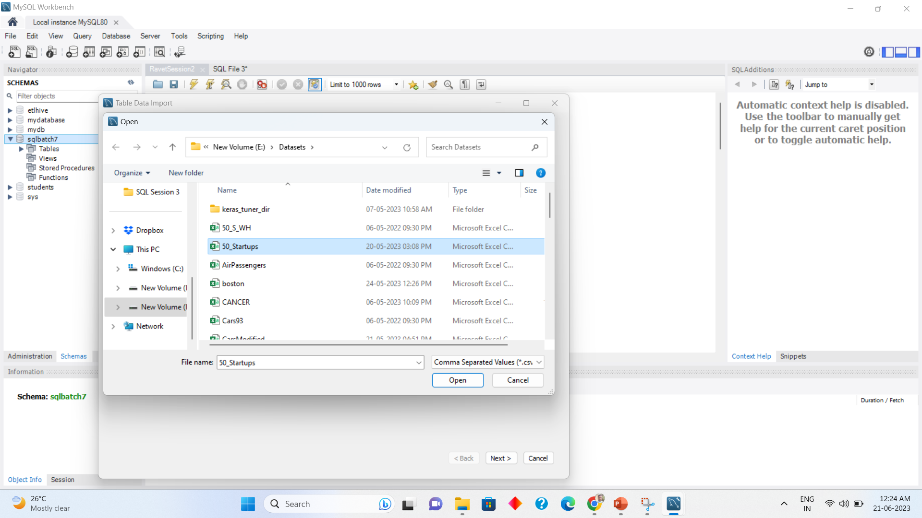
Importing CSV file continued 2
Click open

Slide 5
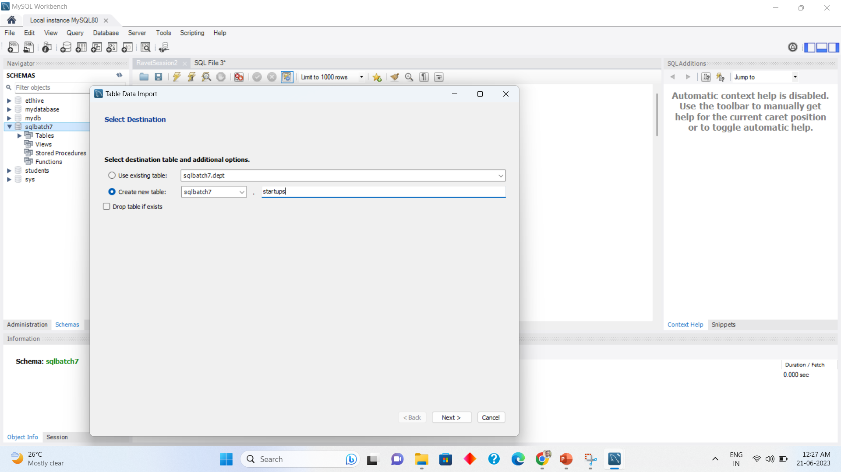
Importing CSV file continued 3
Click Next , next and execute

Slide 6
SELECT QUERY BASIC SYNTAX
Showing entire table
SELECT * FROM Table_Name
Selecting Specific columns from a table
SELECT column_1, column_2, column_3,… FROM Table_Name

Slide 7
Distinct Values (Unique Values)
SELECT DISTINCT column1, column2, ... FROM table_name;

Slide 8
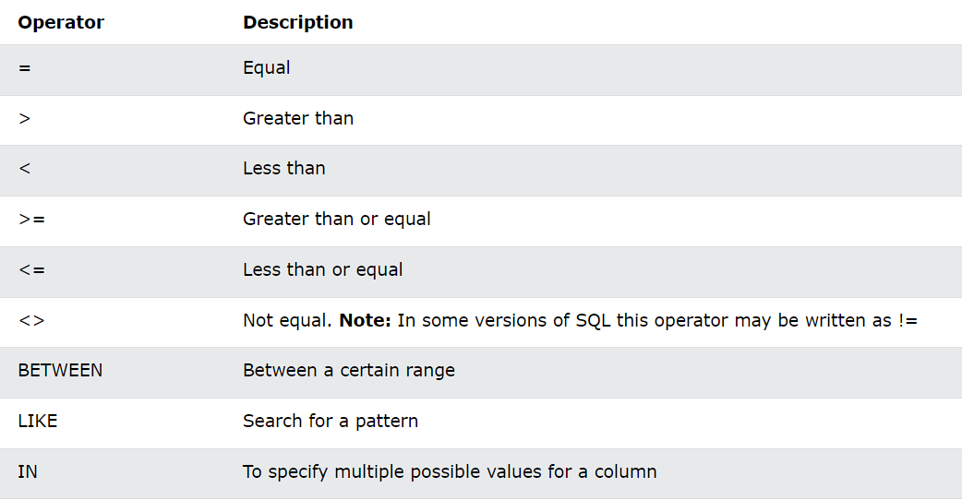
SQL SELECT WHERE CLAUSE
Where clause is used to filter the data
SELECT column1, column2, ... FROM table_name WHERE condition;

Slide 9
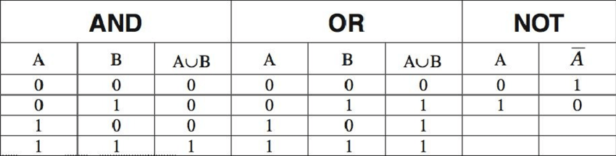
SQL AND , OR , NOT Explained
And is similar to Multiplication = A.B
Or is similar to addition = A+B

Slide 10
AND , OR , NOT Operations
AND Syntax
SELECT column1, column2, ... FROM table_name WHERE condition1 AND condition2 AND condition3 ...;
OR Syntax
SELECT column1, column2, ... FROM table_name WHERE condition1 OR condition2 OR condition3 ...;
NOT Syntax
SELECT column1, column2, ... FROM table_name WHERE NOT condition;

Slide 11
Counting values in SQL
SELECT COUNT(column_name) FROM table_name WHERE condition;

Slide 12
SUM of values
SELECT SUM(column_name) FROM table_name WHERE condition;

Slide 13
Average of Values
SELECT AVG(column_name) FROM table_name WHERE condition;

Slide 14
Thank You
For Any Queries ping me on skype group

